Slide 1
Macroeconomic Factor Pricing Model
Group Member Names

Slide 2
Macroeconomic Factors
Go to https://fred.stlouisfed.org/categories. Here you can download historical economic time-series. Explore the different categories of data. For each team member, identify a variable you want to include in your asset pricing model. The series must be monthly and must cover from January 1997 to December 2016.
On your first slide, state each variable you are adding to your model. Tell me why you believe this variable should economically matter.
Time allotted: 10 minutes

Slide 3
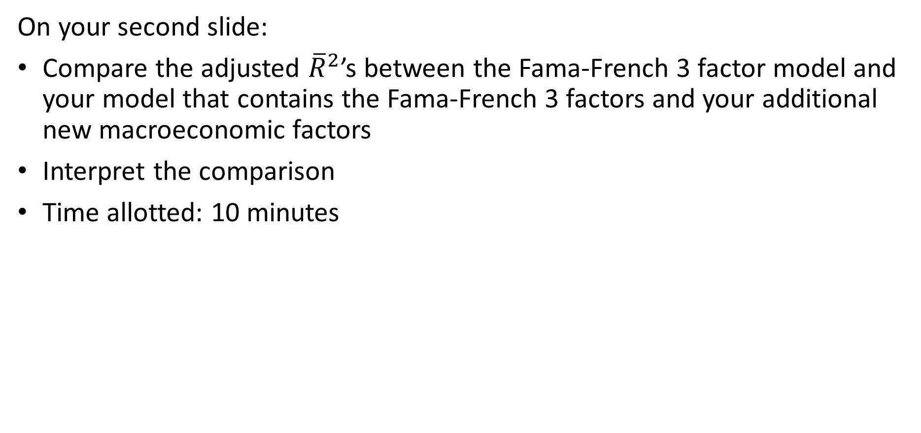
Adjusted ${\overline{R}}^{2}$
On your second slide:
Compare the adjusted ${\overline{R}}^{2}$’s between the Fama-French 3 factor model and your model that contains the Fama-French 3 factors and your additional new macroeconomic factors
Interpret the comparison
Time allotted: 10 minutes

Slide 4
Model Comparison
Using a F-test, determine which is the better asset pricing model: the Fama-French 3 factor model your new model that includes the Fama-French 3 factors and your new macroeconomic factors. On your third slide, state:
The hypothesis of your test.
The P-value of the test.
The statistical conclusion of your tests.
The economic conclusion of your test.
Time allotted: 10 minutes
For each group, submit your Excel file and PowerPoint presentation to https://www.dropbox.com/request/eqvXkowzNdAUT2Lkp00q. Remember to record your group members in your Excel file.

